Slide 1
Feed-forward Neural Networks
Marco Forgione
SUPSI – Scuola Universitaria Professionale della Svizzera Italiana
IDSIA – Dalle Molle Institute for Artificial Intelligence
marco.forgione@supsi.ch

Slide 2
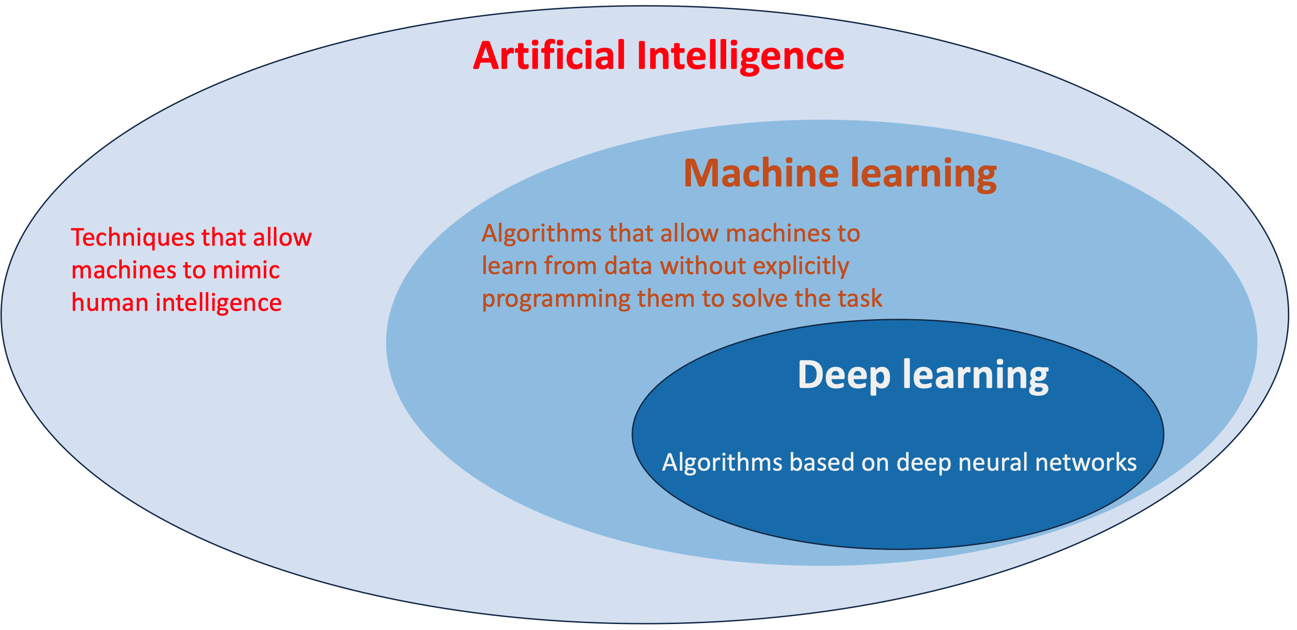
Artificial Intelligence, Machine Learning, Deep Learning

Slide 3
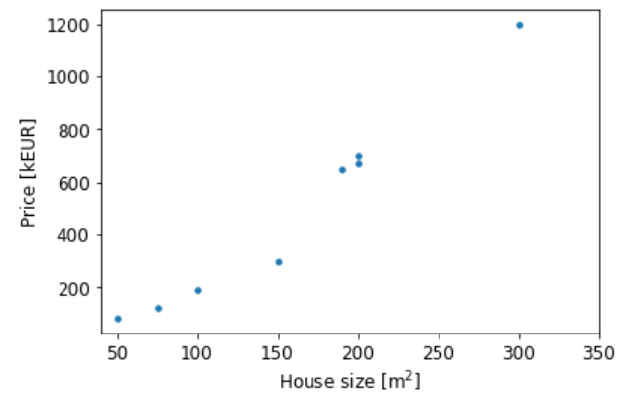
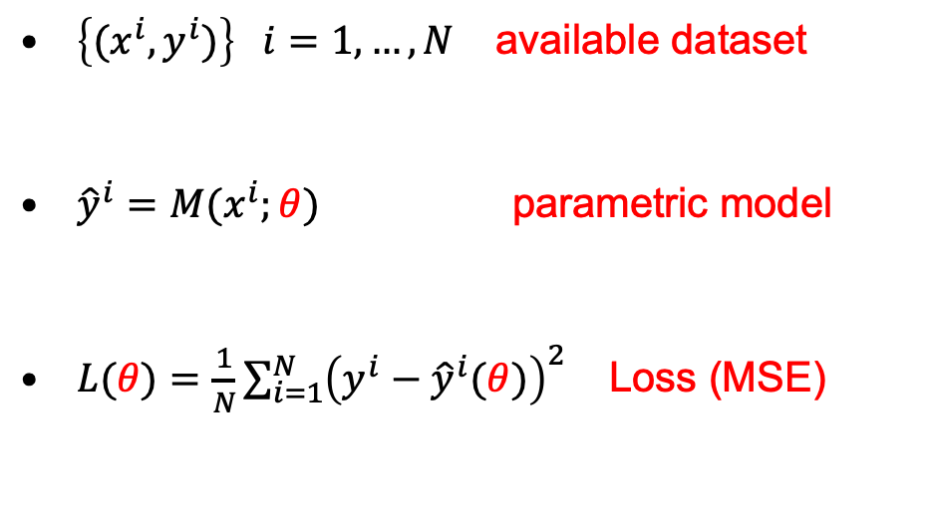

Machine learning: Regression
Real estate application
$\left\{{(x}^{i},y^{i})\right\} i=1,…,N$ available dataset
${\hat{y}}^{i}=M(x^{i};θ)$ parametric model
$L(θ){=\frac{1}{N}\sum_{i=1}^{N}{{\left(y^{i}−{\hat{y}}^{i}(θ)\right)}^{2}}}_{ }$ Loss (MSE)
$$θ^{∗}=arg\min_{θ}{L(θ)}$$

Slide 4
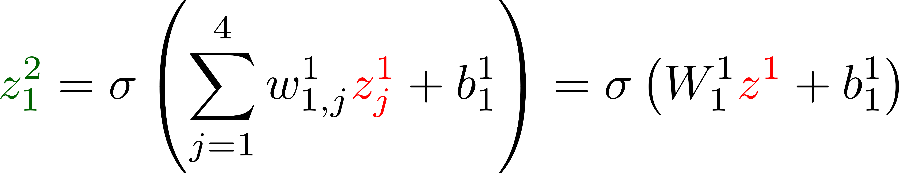
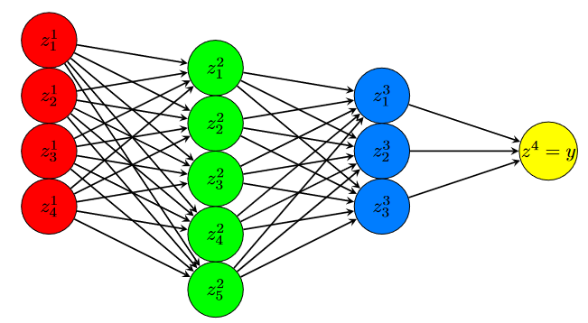
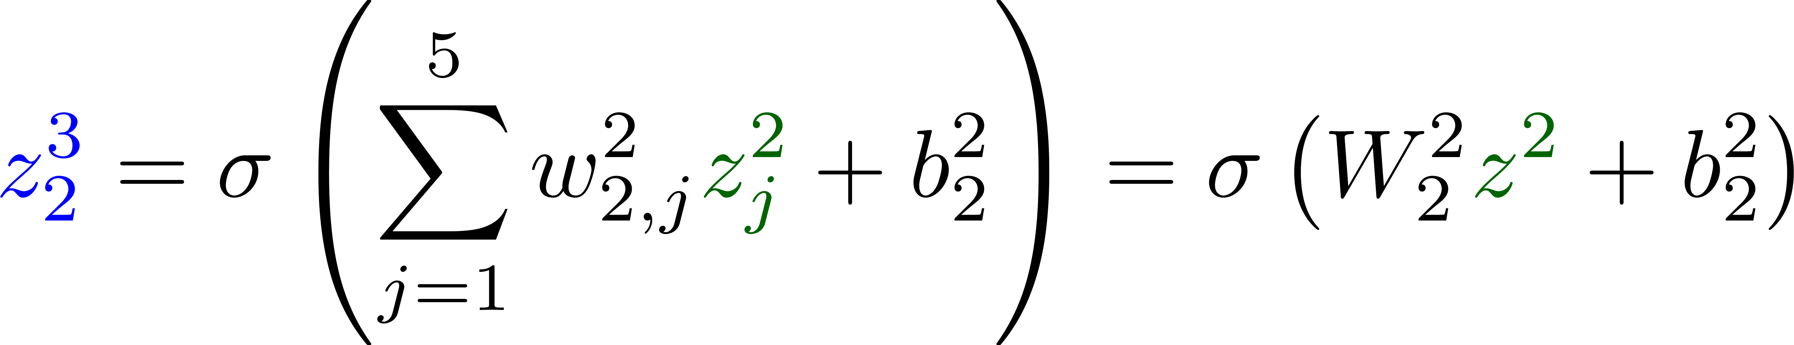
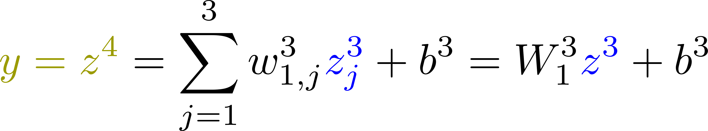
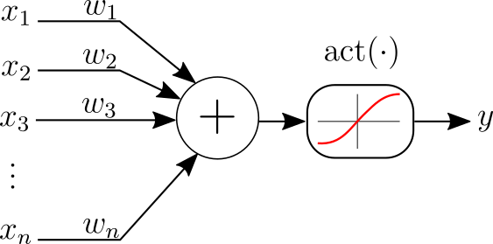
Feed-Forward Neural Networks
It is just a particular model structure
Hidden Layer 1
Hidden Layer 2
Output
Input
For regression, the output neuron typically does not have a nonlinear activation function

Slide 5
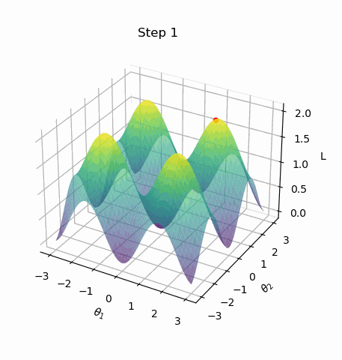
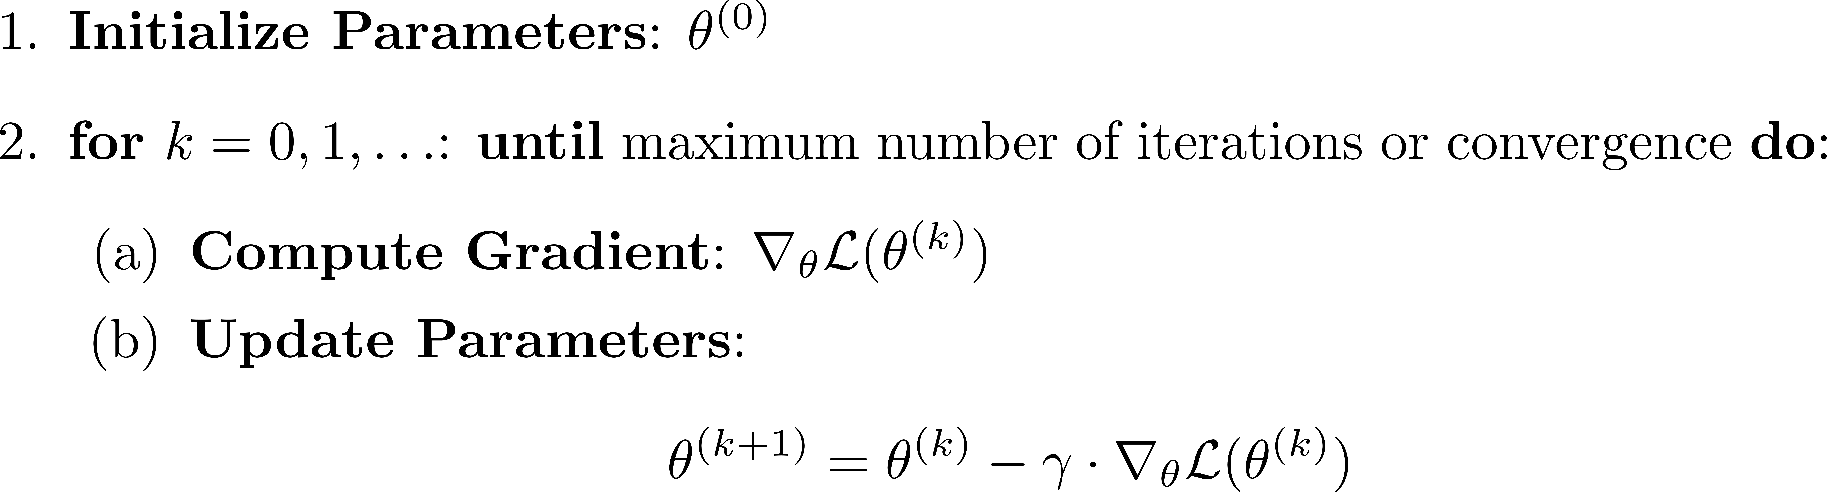
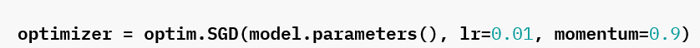
Vanilla Gradient Descent
Nowadays, the adam optimizert (optim.Adam) is a more common variant of vanilla gradient descent.

Slide 6
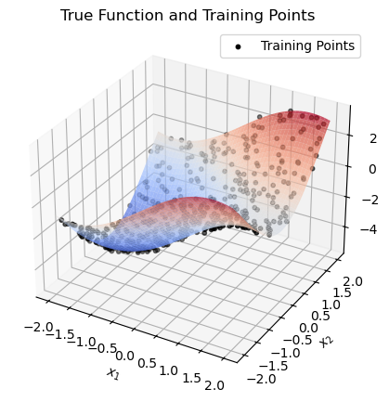
Exercise: synthetic toy dataset (toy_example.ipynb)
Consider the 2D function
Training and test datasets: 500 points uniformly sampled in the domain.
Additive noise with standard deviation 0.1

Slide 7
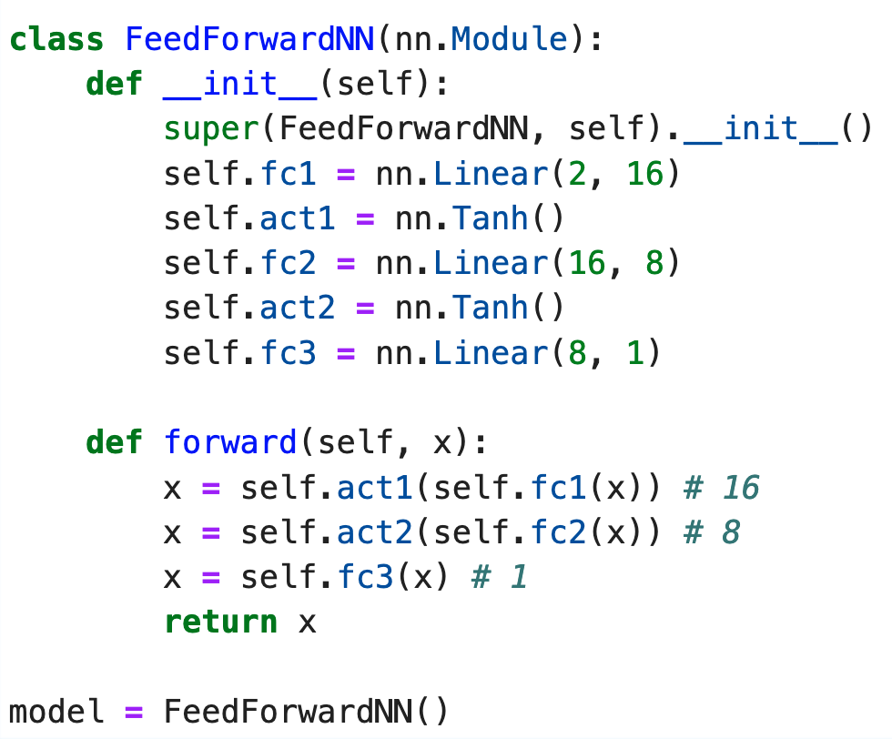
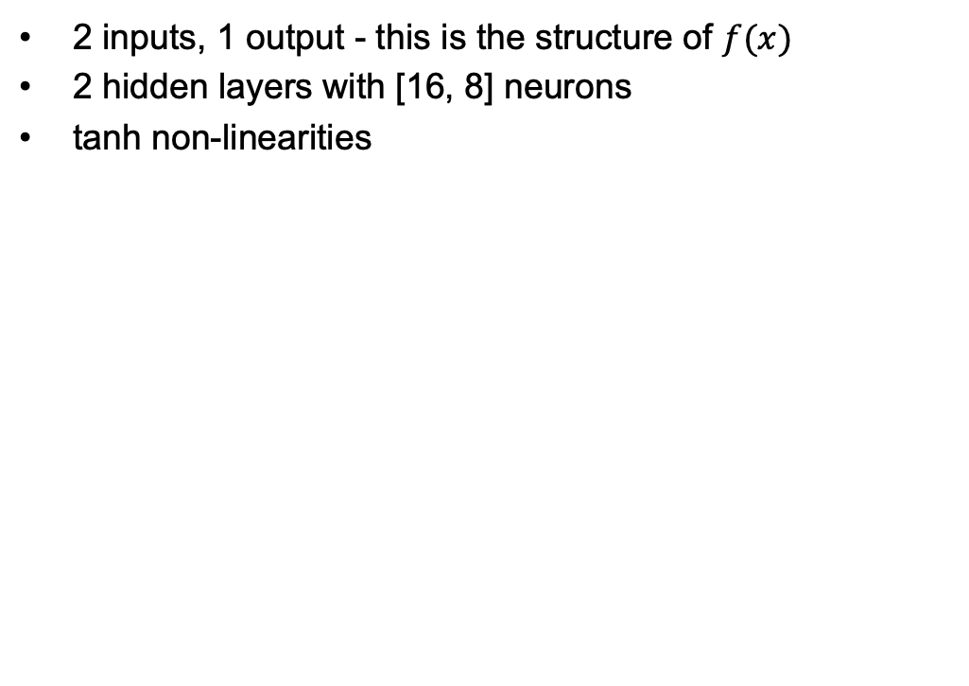
Feed-forward neural network model
2 inputs, 1 output - this is the structure of $f(x)$
2 hidden layers with [16, 8] neurons
tanh non-linearities

Slide 8
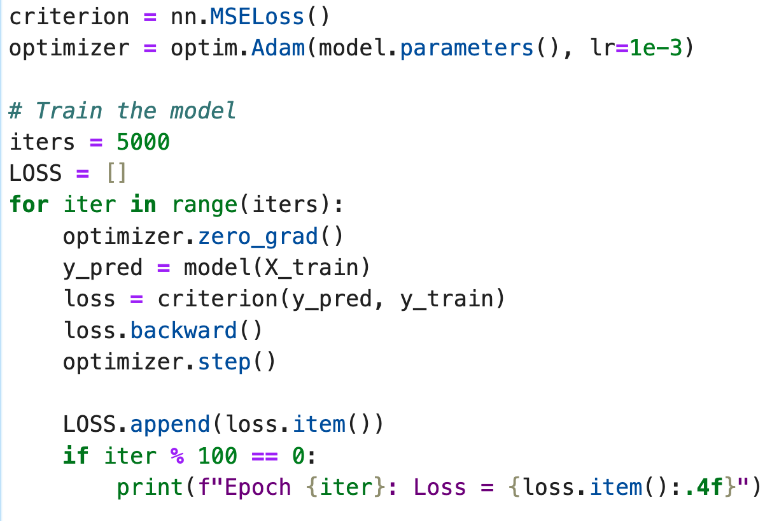
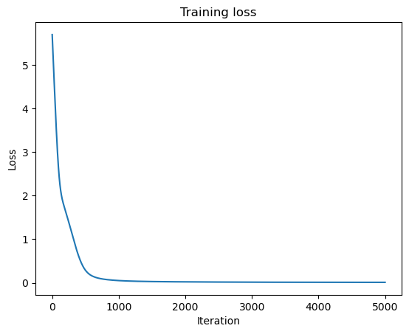
Model training

Slide 9
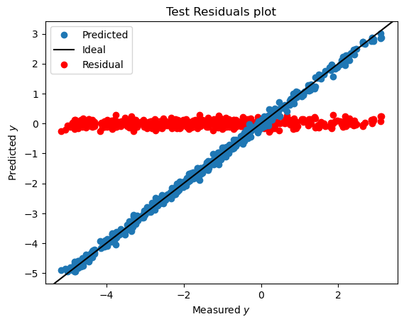
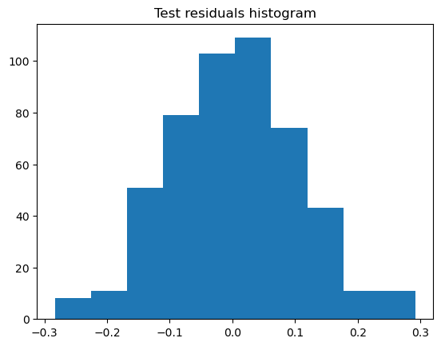
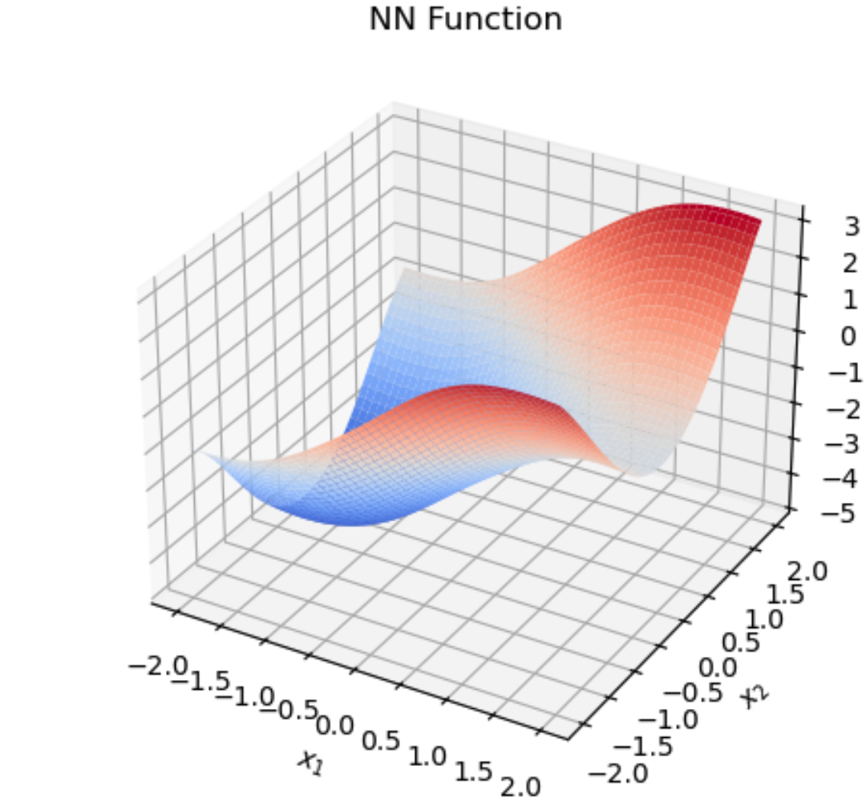
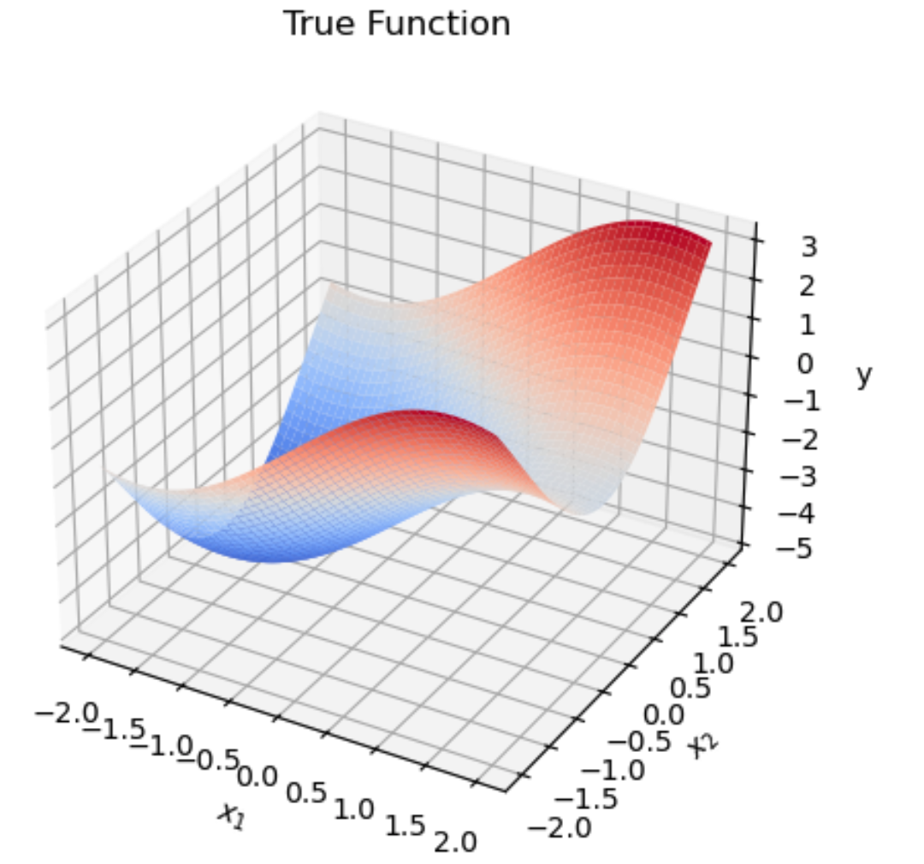
Model evaluation
It is common to inspect, on the test dataset:
Predictions and residuals vs measured y (top left)
Histogram of residuals (top right)
In this toy example, we can do more:
The input is only 2D. We can visualize the learned function over a grid (bottom left)
The true function is known. We can also visualize it in 2D (bottom right)
Everything seems to work well!

Slide 10
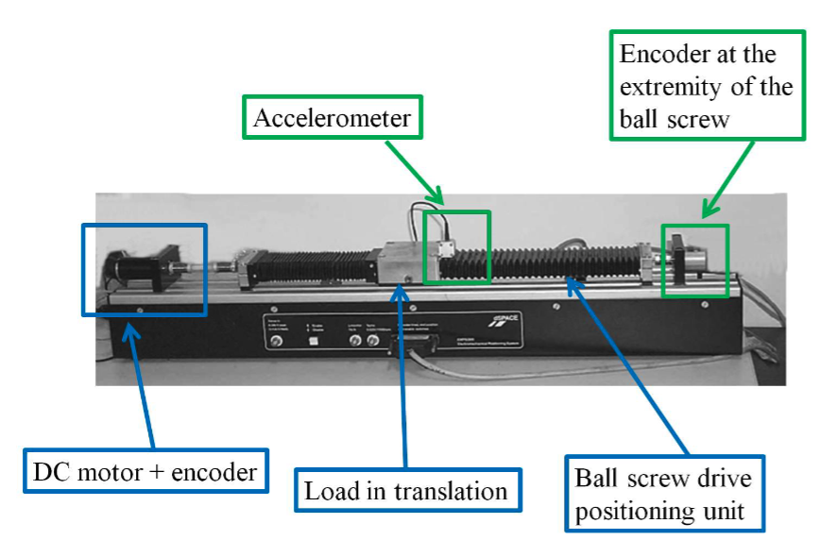
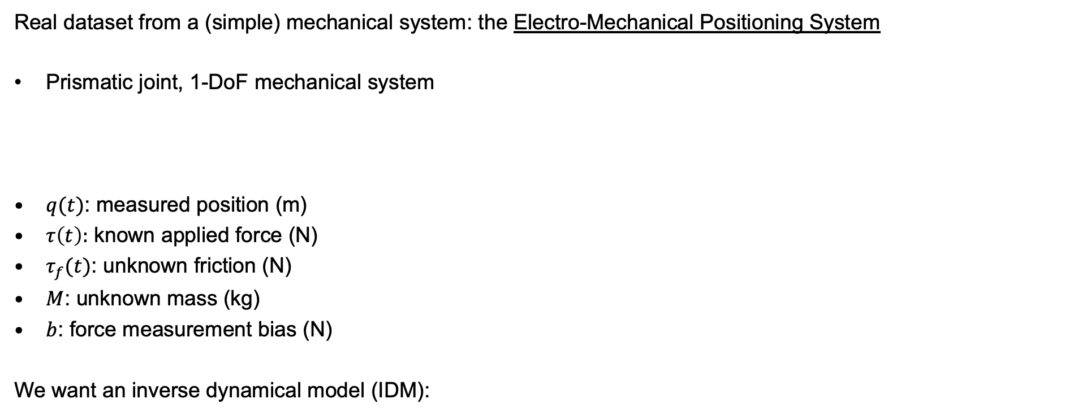
Inverse Dynamical Modeling on the EMPS benchmark (emps_exercise.ipynb)
Real dataset from a (simple) mechanical system: the Electro-Mechanical Positioning System
Prismatic joint, 1-DoF mechanical system
$q(t)$: measured position (m)
$τ\left(t\right):$ known applied force (N)
$τ_{f}(t)$: unknown friction (N)
$M$: unknown mass (kg)
$b$: force measurement bias (N)
We want an inverse dynamical model (IDM):

Slide 11
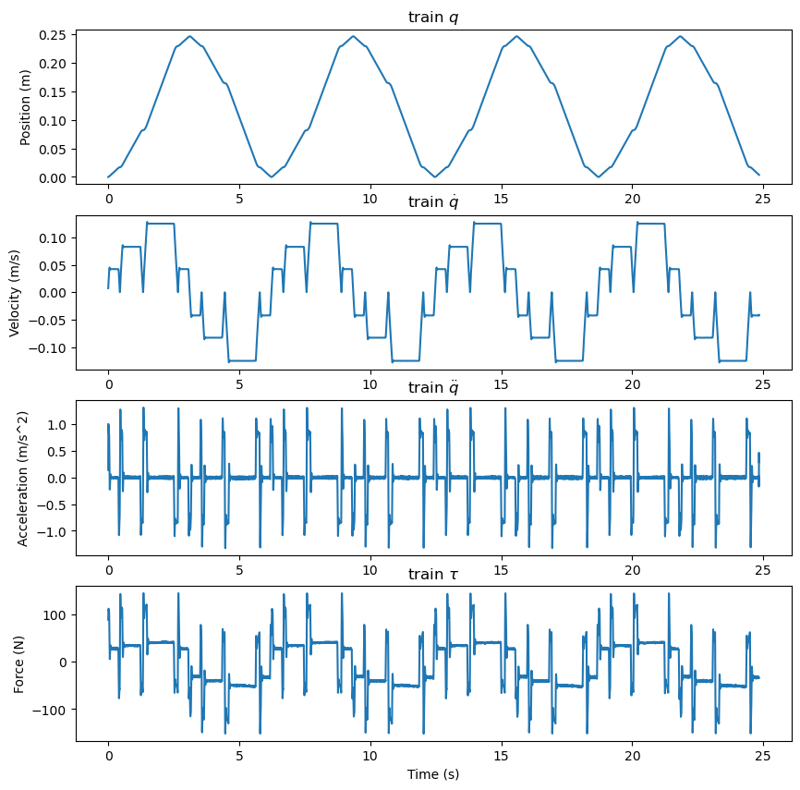
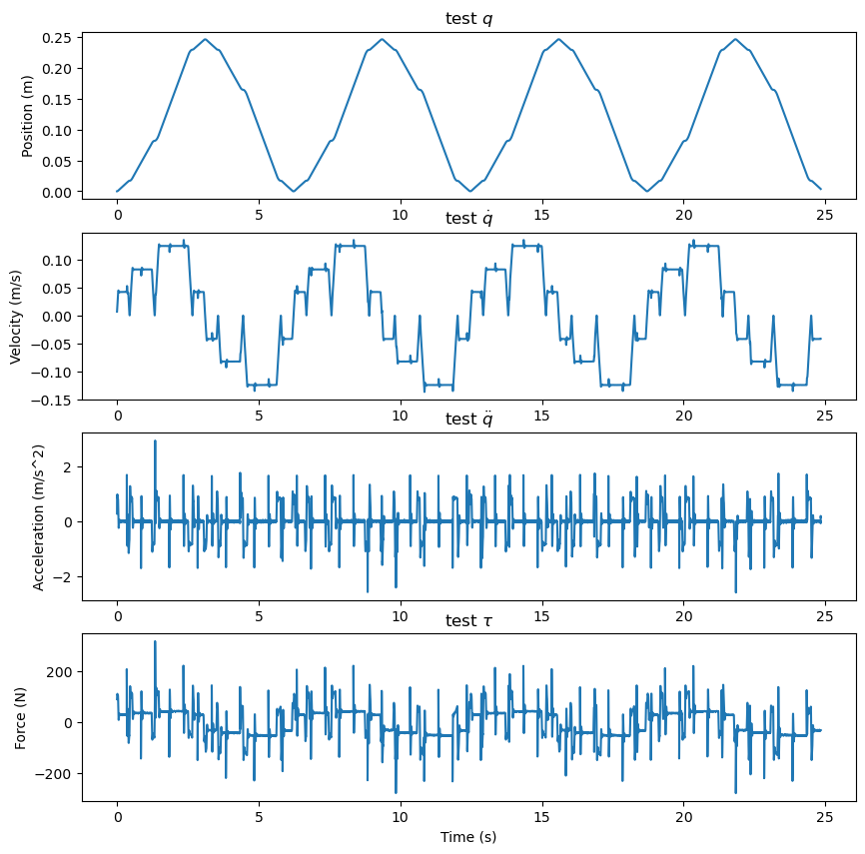
Training and test datasets

Slide 12
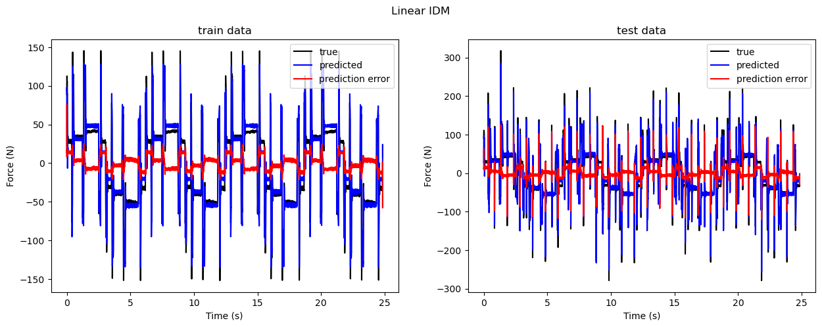
Linear model
We assume a linear friction model:
Then, the IDM is: . We can fit the IDM with a linear regression:

Slide 13
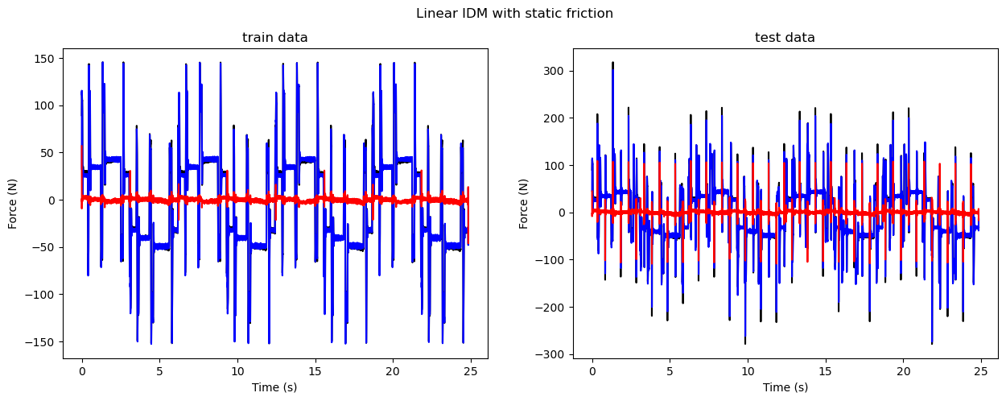
Linear model with static friction
We use a more sophisticated friction model:

Slide 14
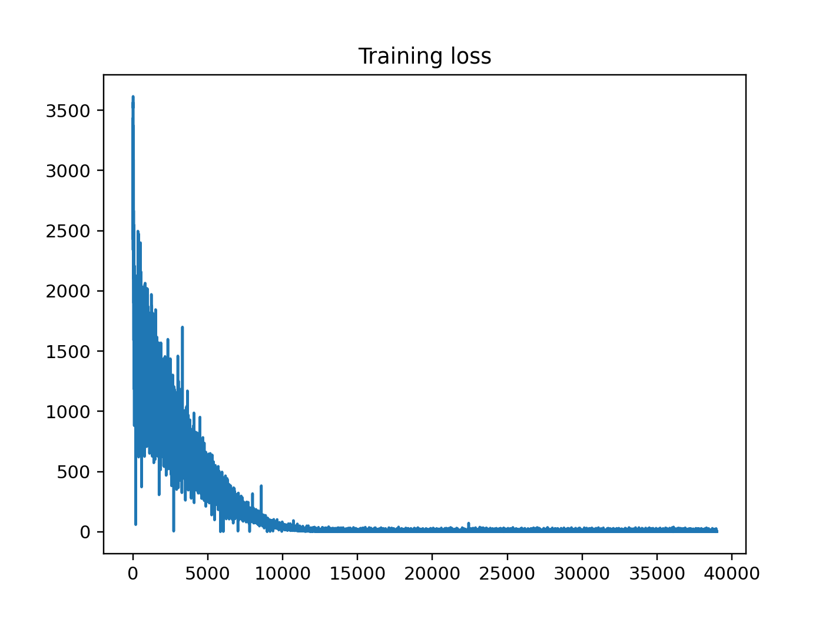
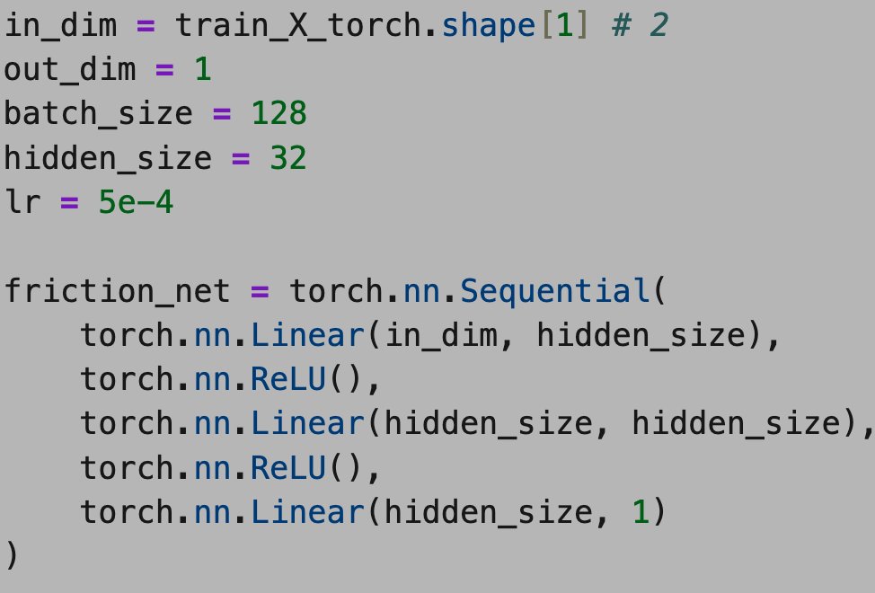
Feed-forward neural network
We ignore all physics and fit a feed-forward neural network instead:
Train it yourself!

Slide 15
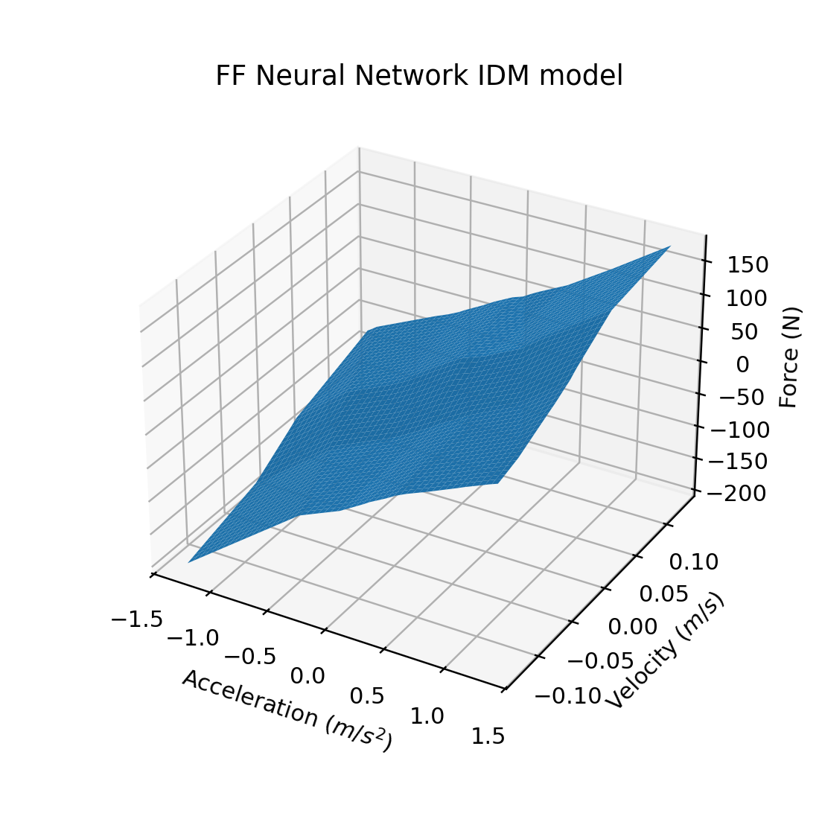
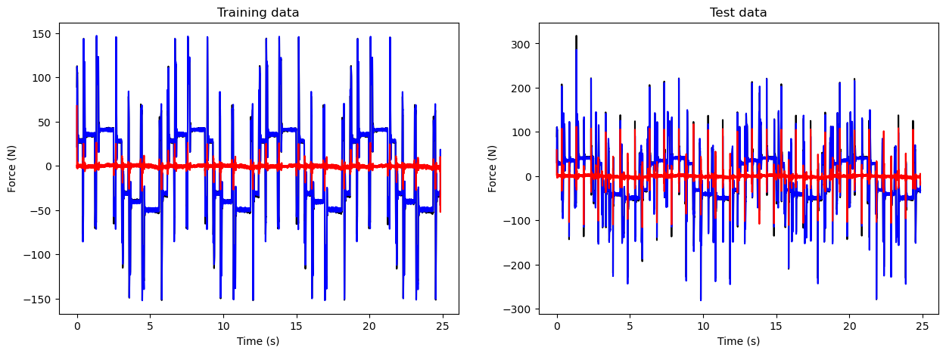
Feed-forward neural network
Train it yourself!

Slide 16
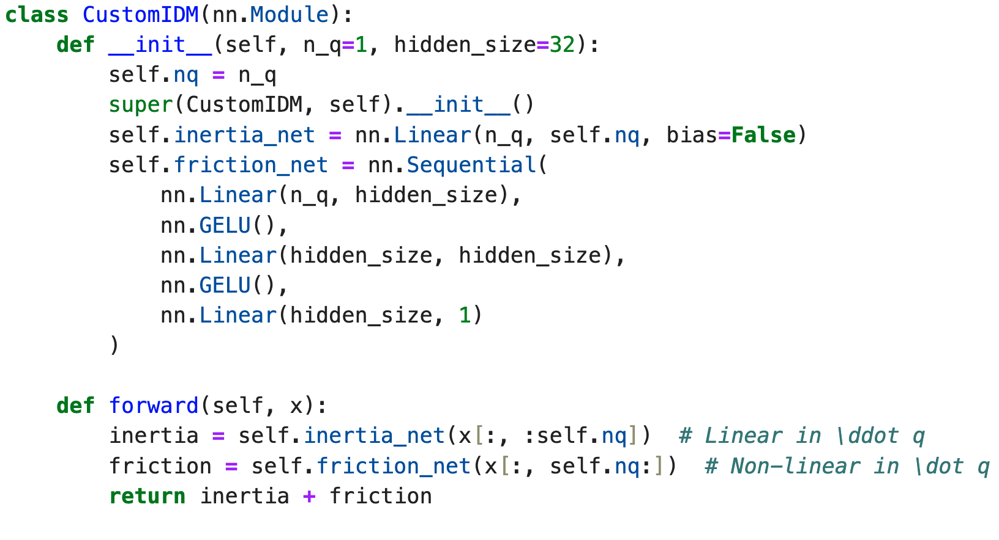
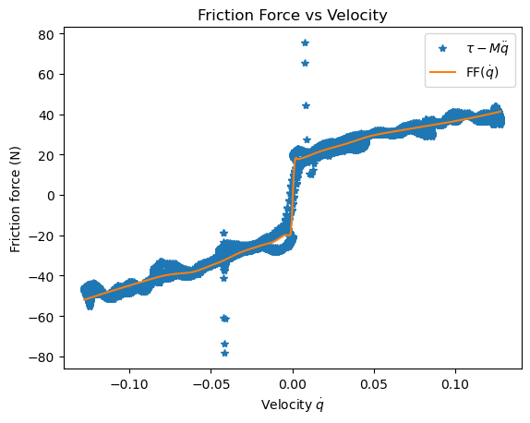
Physics-inspired neural network
We trust Newton’s law, but nothing else:
Train it yourself!

